Slide 2
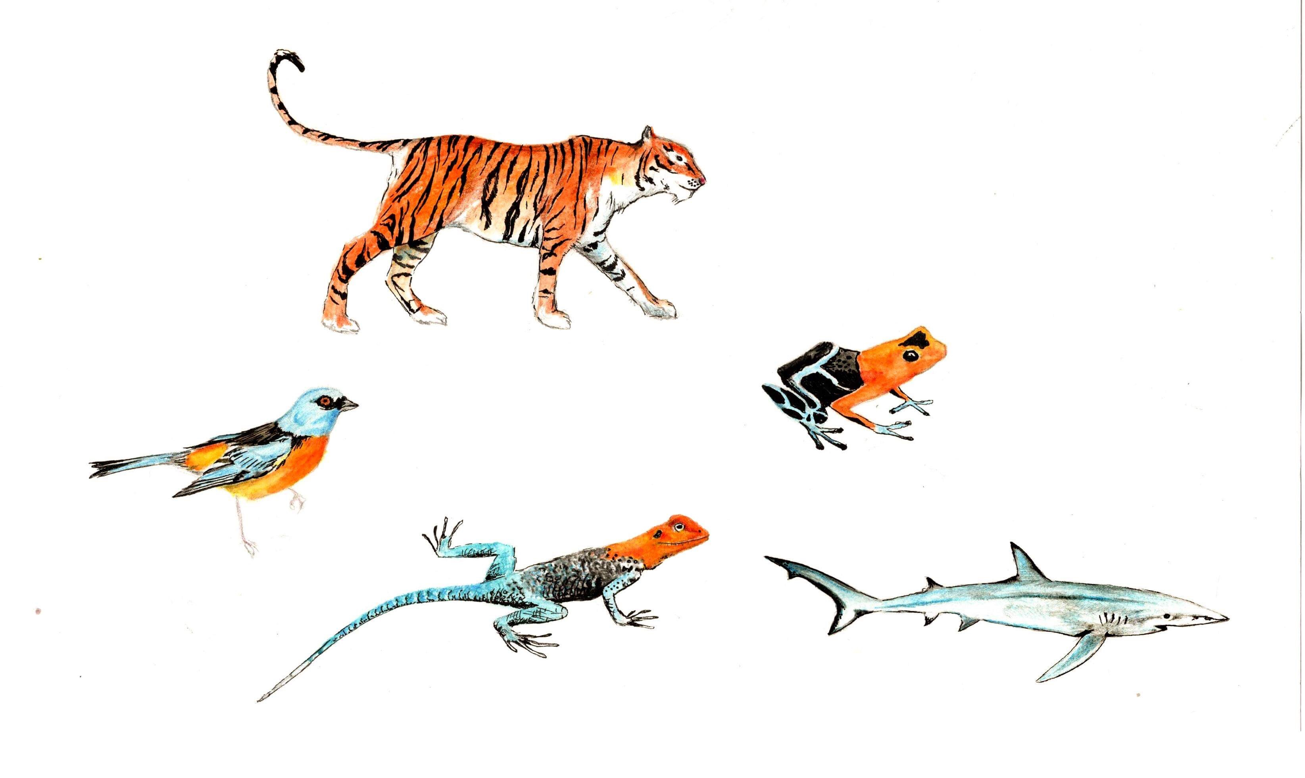
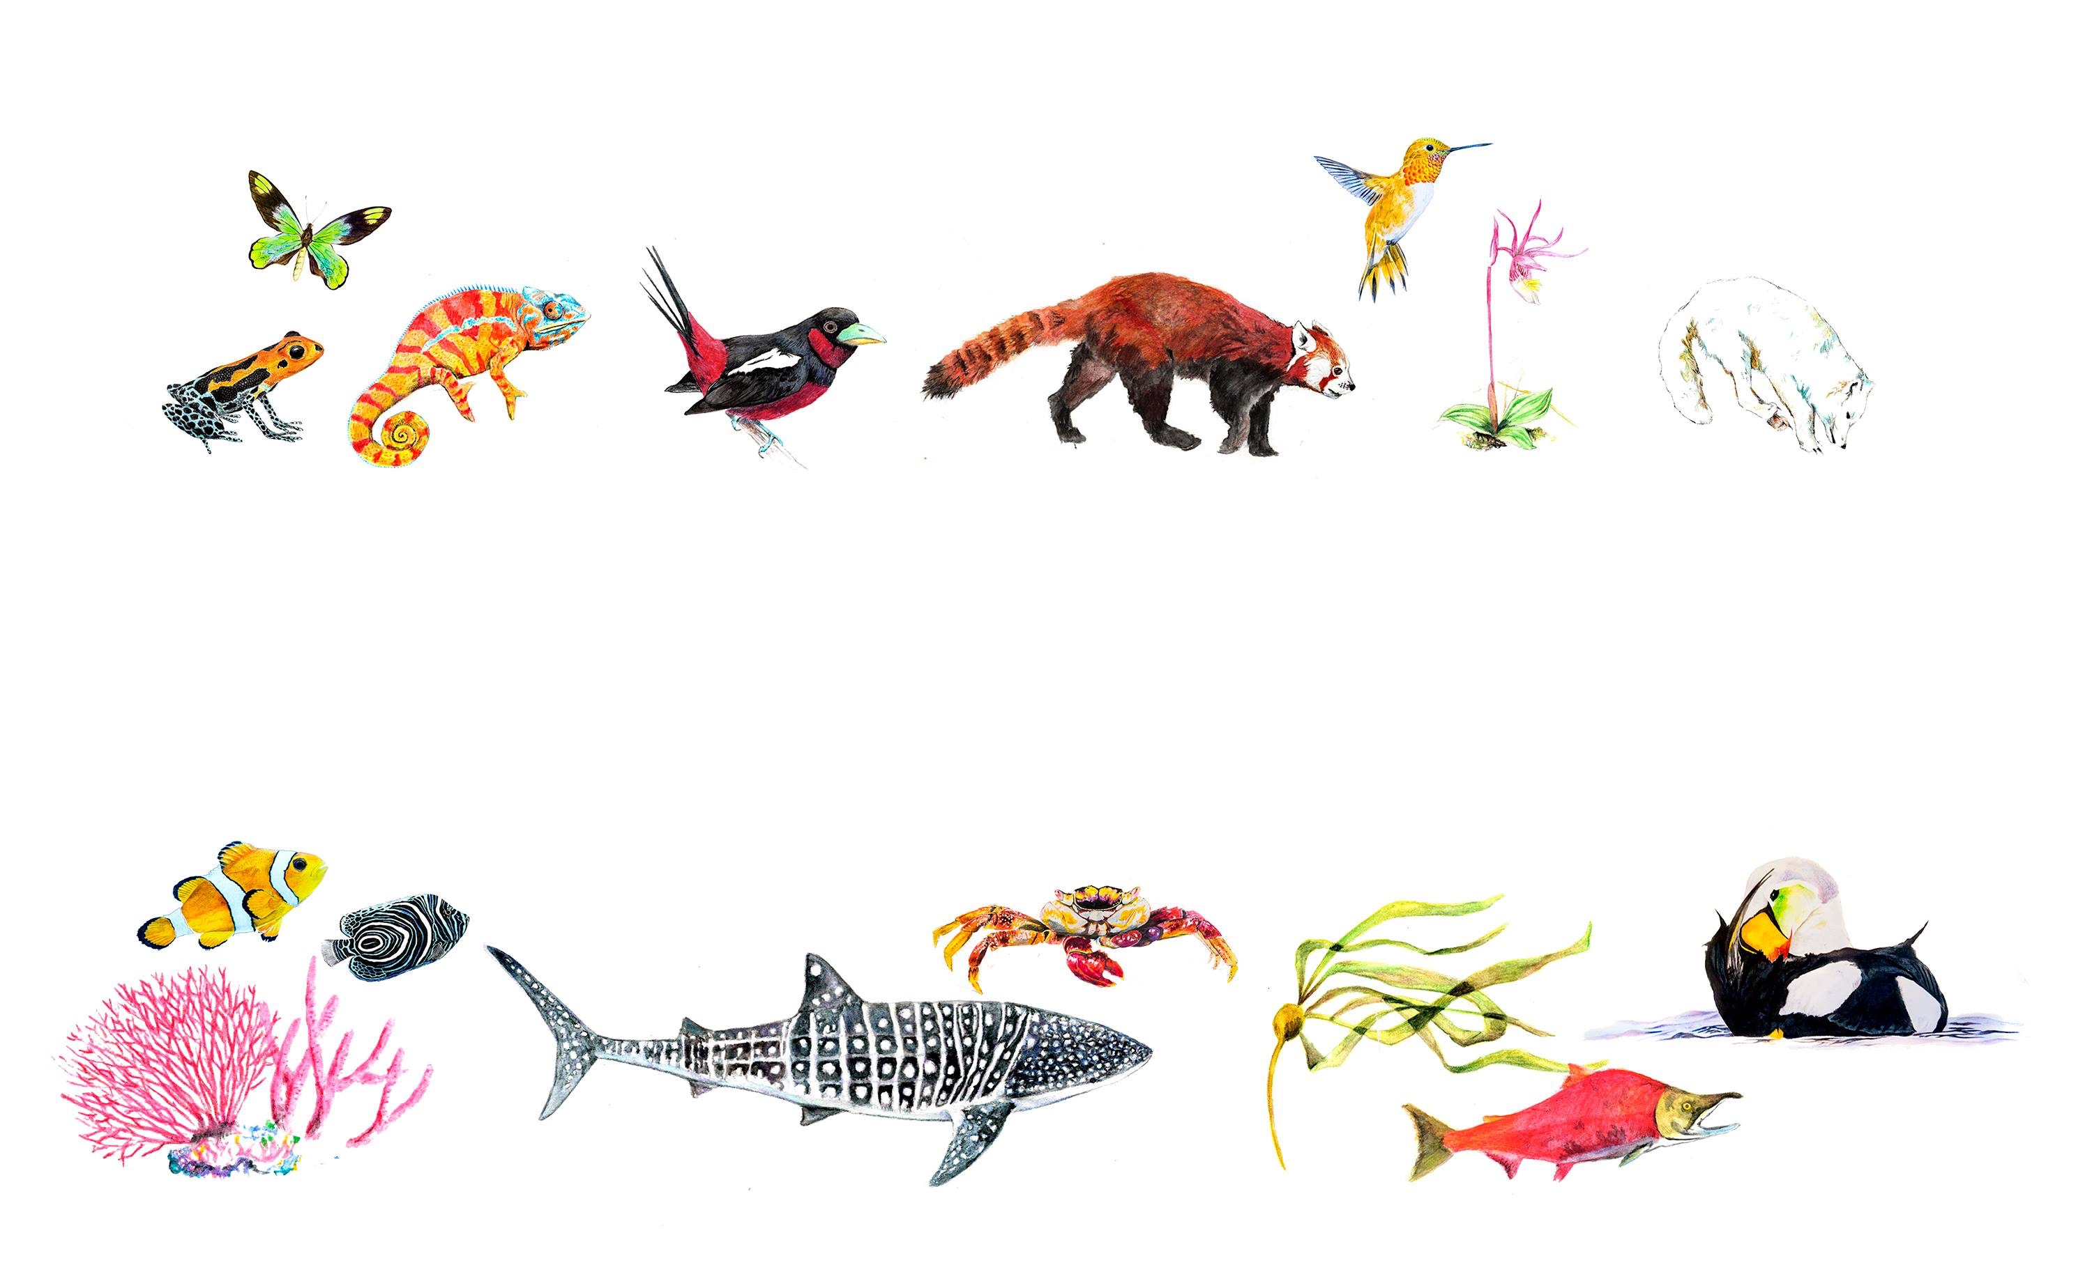

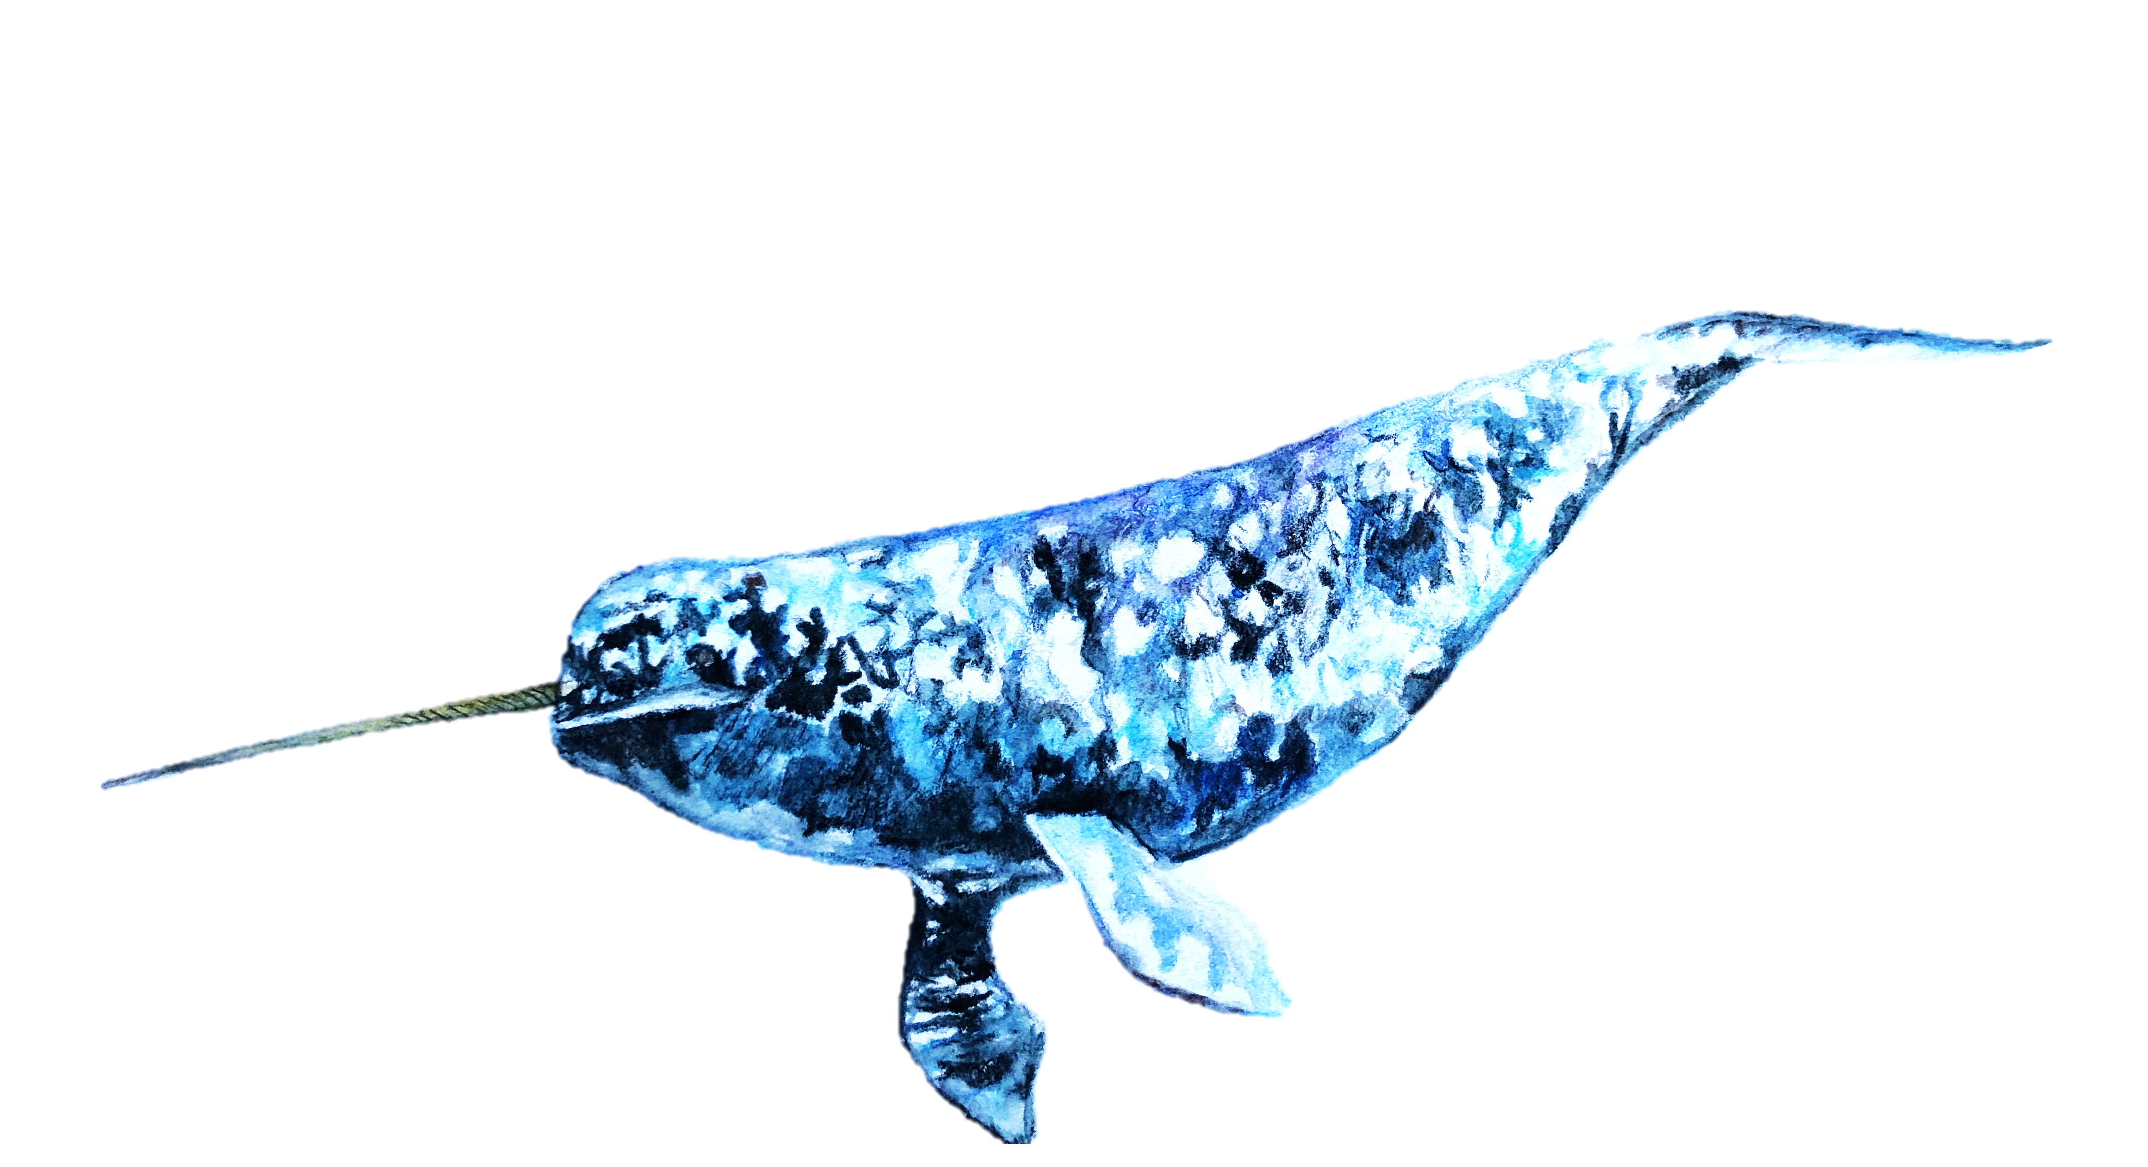
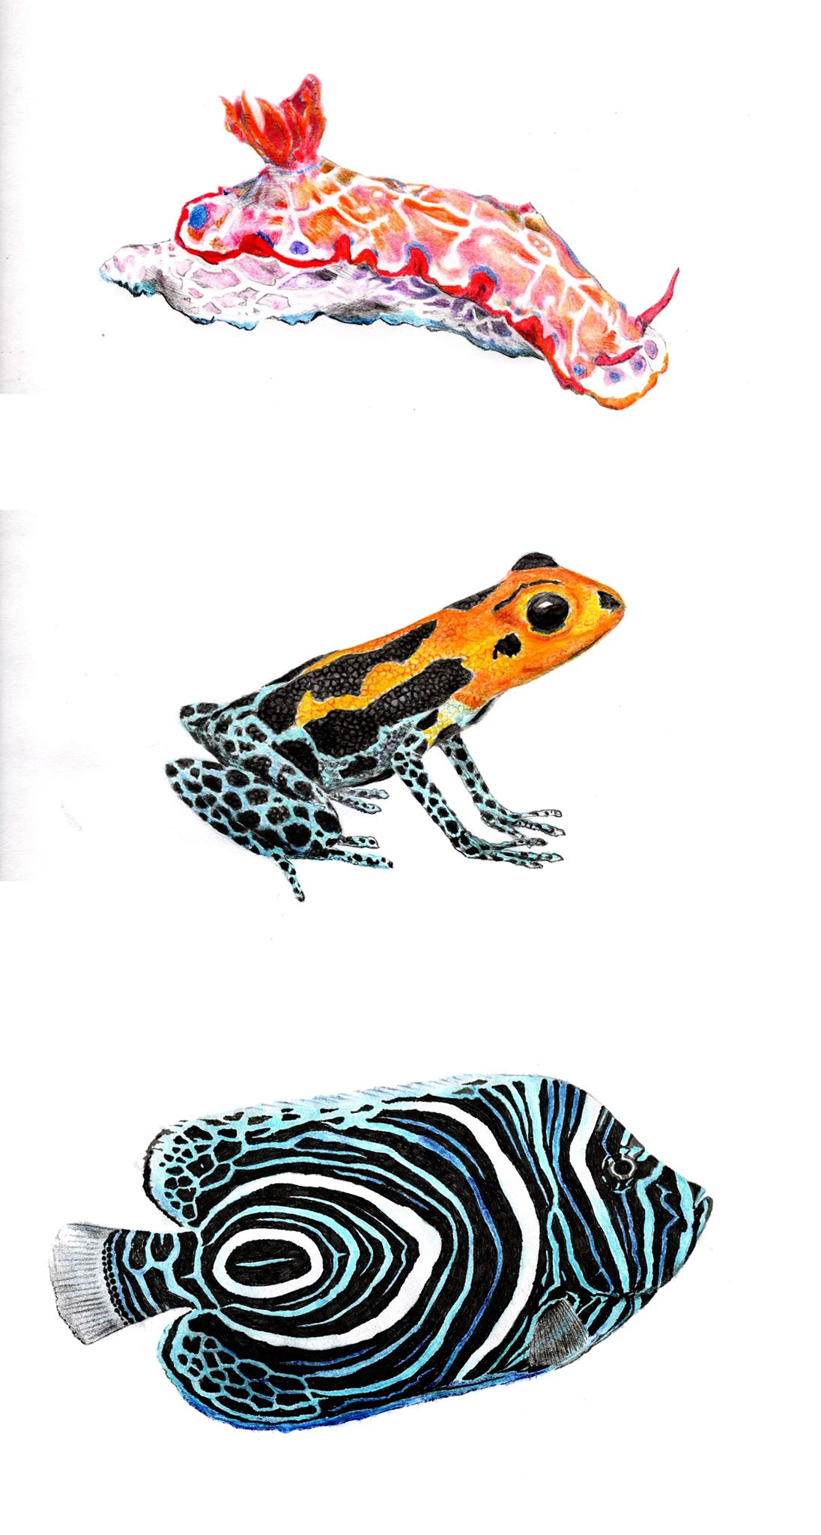

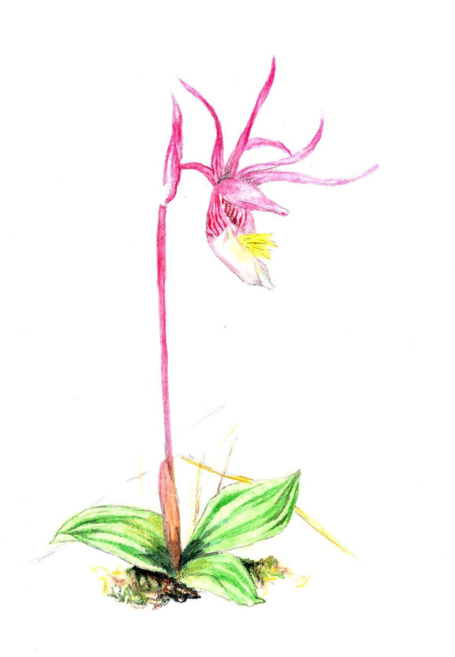
Living Planet BioTIME PREDICTS
In database / Known
Birds
968 / 10,356
2263 / 10,356
3199 / 10,356
Bony fish
1%
544 / 32,513
6140 / 32,513
0 / 32,513
19%
Mammals
306 / 5,852
285 / 5,852
577 / 5,852
Amphibians
1%
78 / 6,439
114 / 6,439
397 / 6,439
Sharks
62 / 1,226
0 / 1,226
0 / 1,226
Reptiles
110 / 10,233
47 / 10,233
352 / 10,233
Terrestrial plants
0 / 348,000
5965 / 348,000
7655 / 348,000
Arthropods
0 / 1,257,040
3699 / 1,257,040
8767 / 1,257,040
0%
10%
20%
30%
100%
Percentage of known species represented in databases

Slide 3
a Terrestrial
N = 4640
N = 2191
N = 468
b Marine
Living Planet
BioTIME
PREDICTS
Global change space
N = 2700
N = 42341

Slide 4
a Terrestrial distributions
b Marine distributions
Living Planet
Living Planet
Human population
Global distribution
c Terrestrial model predictions
d Marine model predictions
Climate change
Human use
Human population
Pollution
Invasions
Cumulative
Climate change
Human use
Human population
Pollution
Invasions
Cumulative

Slide 5
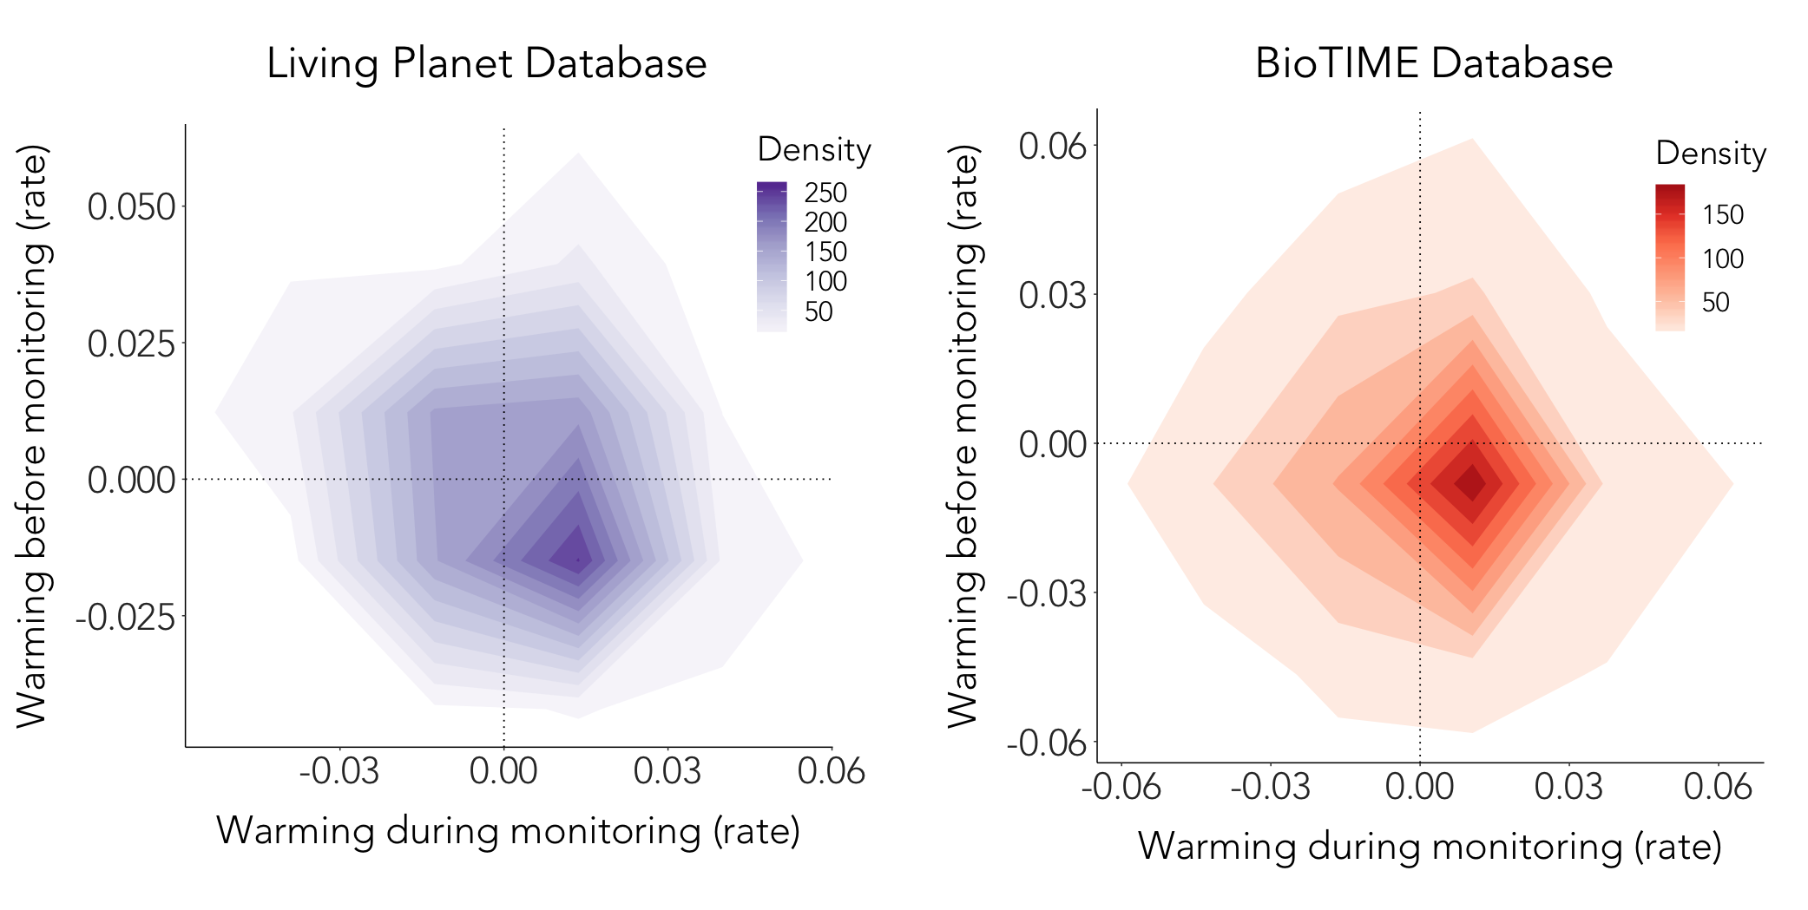
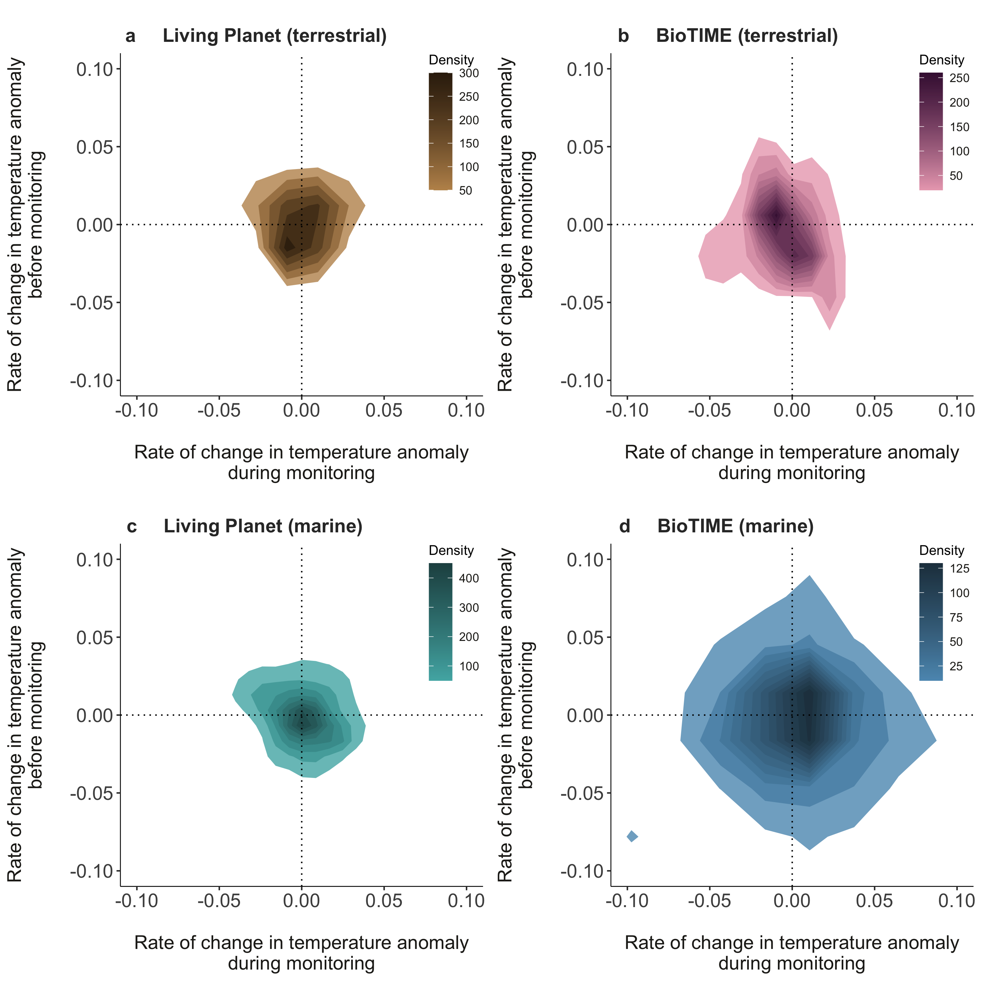

Slide 7
Warming before,
Warming during
Cooling before,
Warming during
Cooling before, cooling during
Cooling before, warming during

